Slide 1
Guidelines for Internal-I
CSEN3103-Sec A, Prepared by Nilina Bera, CSE, HIT

Slide 2
The bounded buffer problem is also known as :
a) Readers – Writers problem
b) Dining – Philosophers problem
c) Producer – Consumer problem
d) None of these
In the bounded buffer problem, there are the empty and full semaphores that :
a) count the number of empty and full buffers
b) count the number of empty and full memory spaces
c) count the number of empty and full queues
d) None of these
Answer: c
Answer: a

Slide 3
In the bounded buffer problem :
a) there is only one buffer
b) there are n buffers ( n being greater than one but finite)
c) there are infinite buffers
d) the buffer size is bounded
To ensure difficulties do not arise in the readers – writers problem, _______ are given exclusive access to the shared object.
a) readers
b) writers
c) None of these
Answer: b
Answer: b

Slide 4
The dining – philosophers problem will occur in case of :
a) 5 philosophers and 5 chopsticks
b) 4 philosophers and 5 chopsticks
c) 3 philosophers and 5 chopsticks
d) 6 philosophers and 5 chopsticks
Answer: a

Slide 5


Slide 6

Questions
A process can be terminated due to
a) normal exit
b) fatal error
c) killed by another process
d) all of the mentioned
Answer : d, divide by zero can be considered as fatal error
What is the ready state of a process?
a) when process is scheduled to run after some execution
b) when process is unable to run until some task has been completed
c) when process is using the CPU
d) none of the mentioned
Answer : a
Explanation : When process is unable to run until some task has been completed, the process is in blocked state and if process is using the CPU, it is in running state.

Slide 7

Questions
What is interprocess communication?
a) communication within the process
b) communication between two process
c) communication between two threads of same process
d) none of the mentioned
Answer : b
A set of processes is deadlock if
a) each process is blocked and will remain so forever
b) each process is terminated
c) all processes are trying to kill each other
d) none of the mentioned
Answer : a
A process stack does not contain
a) function parameters b) local variables
c) return addresses d) PID of child process
Answer : d

Slide 8

Each request requires that the system consider the __________, _____________, ____________ to decide whether the current request can be satisfied or must wait to avoid a future possible deadlock. (choose three)
a) resources currently available
b) processes that have previously been in the system
c) resources currently allocated to each process
d) future requests and releases of each process
Answer: a, c and d
Given a priori information about the ________ number of resources of each type that maybe requested for each process, it is possible to construct an algorithm that ensures that the system will never enter a deadlock state.
a) minimum
b) average
c) maximum
d) approximate
Answer: c

Slide 9

Process Synchronization & Deadlock
A deadlock avoidance algorithm dynamically examines the __________, to ensure that a circular wait condition can never exist.
a) resource allocation state
b) system storage state
c) operating system
d) resources
Answer: a
Explanation: Resource allocation states are used to maintain the availability of the already and current available resources.
A state is safe, if :
a) the system does not crash due to deadlock occurrence
b) the system can allocate resources to each process in some order and still avoid a deadlock
c) the state keeps the system protected and safe
d) All of these
Answer: b

Slide 10

Questions & Answers
A system is in a safe state only if there exists a :
a) safe allocation
b) safe resource
c) safe sequence
d) All of these
Answer: c
CPU fetches the instruction from memory according to the value of
a) program counter
b) status register
c) instruction register
d) program status word
Answer : a

Slide 11

B.Tech(CSE) - Process
Which system call returns the process identifier of a terminated child?
a) wait
b) exit
c) fork
d) get
Answer : a; The system call wait() is easy. This function blocks the calling process until one of its child processes exits or a signal is received. wait() takes the address of an integer variable and returns the process ID of the completed process.
The address of the next instruction to be executed by the current process is provided by the
a) CPU registers
b) program counter
c) process stack
d) pipe
Answer : b

Slide 12
B.Tech(CSE) - Process
General structure of a process consists of
Critical section b) remainder section
c) Race condition d) both a) and b)
d)
Scheduling a process from Ready Queue to CPU is done by:
a) Short Term Scheduler
b) Middle Term Scheduler
c) Long Term Scheduler
d) Dispatcher
a)

Slide 13

B.Tech(CSE) - Process
1. A thread is a
Task b) process
c) Program d) light weight process
d)
2. Banker’s Algorithm for Resource Allocation deals with
Deadlock prevention b) deadlock avoidance
c) Deadlock recovery d) mutual exclusion
b)
3. An OS contains 3 user process each requiring 2 units of resources R. The minimum number of units of R such that no deadlocks will ever arise is:
a) 3 b) 5 c) 4 d) 6
c)
P1
P2
P3
R1
R2
R3
R4

Slide 14

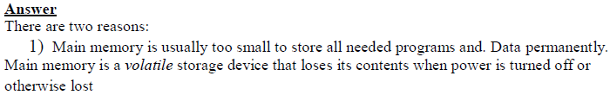
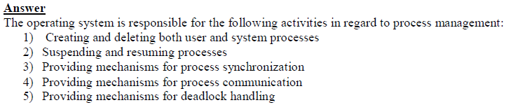
OS questions

Slide 15

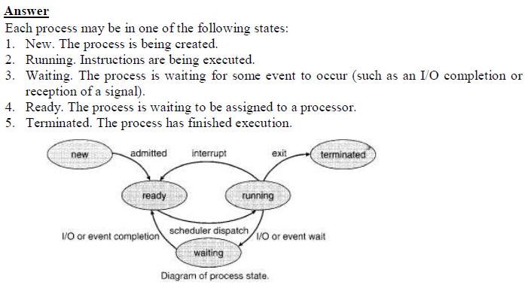

Slide 16
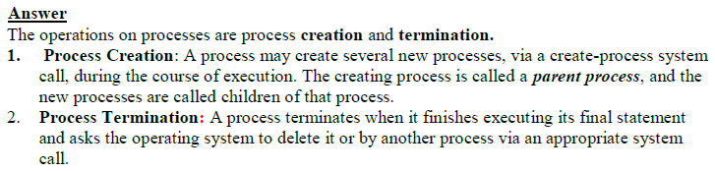
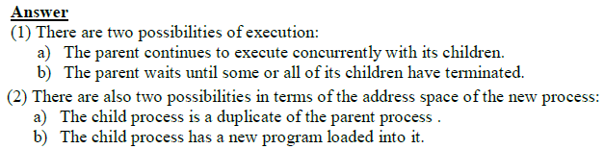

Slide 17
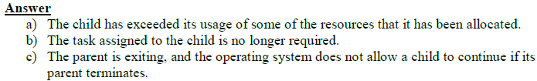
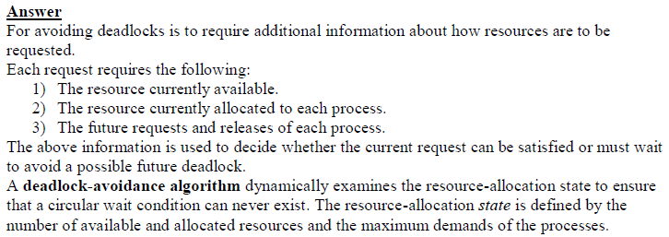

Slide 18

OS questions
What are the requirements of solution the critical-section problem?
The requirements are:
1. Mutual exclusion. If process Pi is executing in its critical section, then no
other processes can be executing in their critical section.
2. Progress. If no process is executing in its critical section and some
processes wish to enter their critical section, then only those processes that
are not executing in their remainder sections can participate in the decision
on which will enter its CS next, and this selection cannot be postponed
indefinitely. (No process should have to wait forever to enter its critical
section.
3. Bounded waiting. There exists a bound, or limit, on the number of times
that other processes are allowed to enter their critical sections after a process
has made a request to enter its critical section and before that request is
granted

